Slide 1
Day 2 Visual Computing FDP Topic: Image Classification in CV A picture is worth a thousand words.

Slide 2
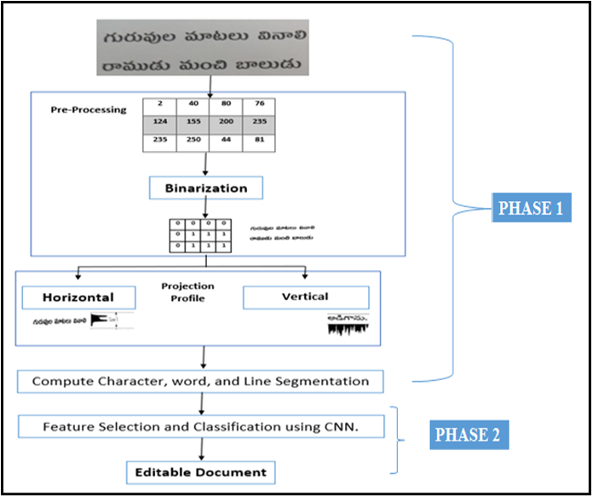
Research Problem Statement 1
Design a novel model to recommend
the text from scanned document

Slide 3
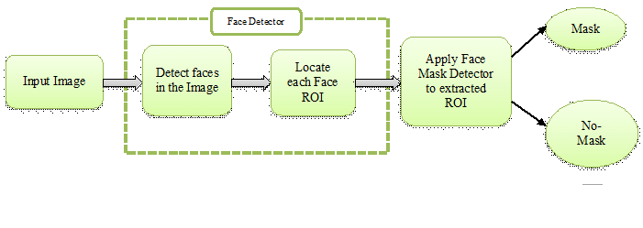
Research problem statement 2
Design a model to detect face mask

Slide 4
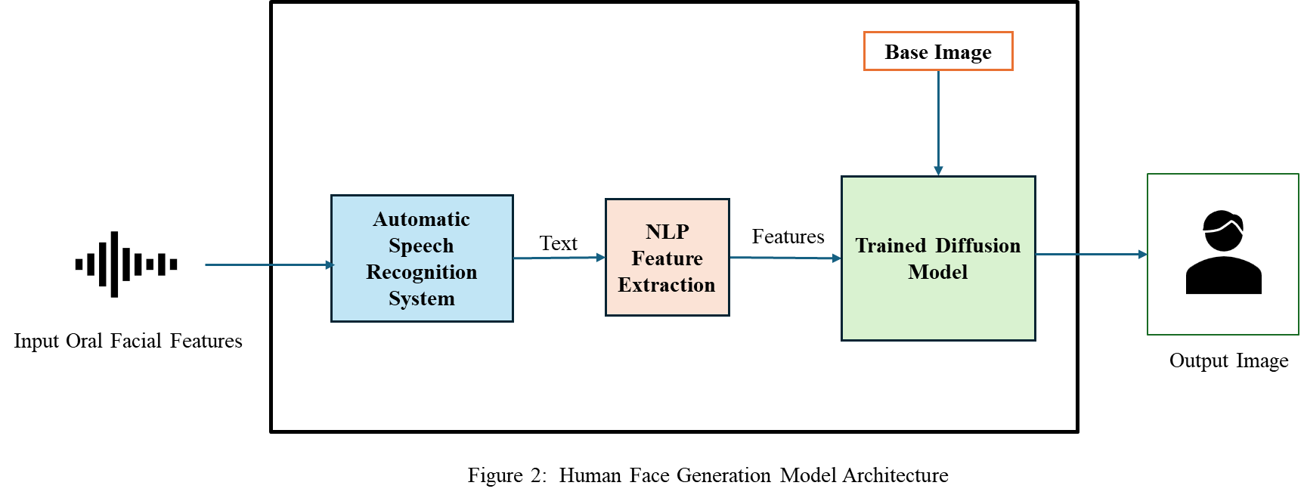
Research problem statement 3
Design an efficient model to generate a Human face using Diffusion models to identify Criminals

Slide 5

What is Image Classification?
Image classification is the task of categorizing and assigning labels to groups of pixels or vectors within an image dependent on particular rules. The categorization law can be applied through one or multiple spectral or textural characterizations.

Slide 6
Supervised Classification
Supervised classification is based on the idea that a user can select sample pixels in an image that are representative of specific classes and then direct the image processing software to use these training sites as references for the classification of all other pixels in the image.
Supervised classification uses classification algorithms and regression techniques to develop predictive models.
The algorithms include linear regression, logistic regression, neural networks, decision tree, support vector machine, random forest, naive Bayes, and k-nearest neighbor.

Slide 7
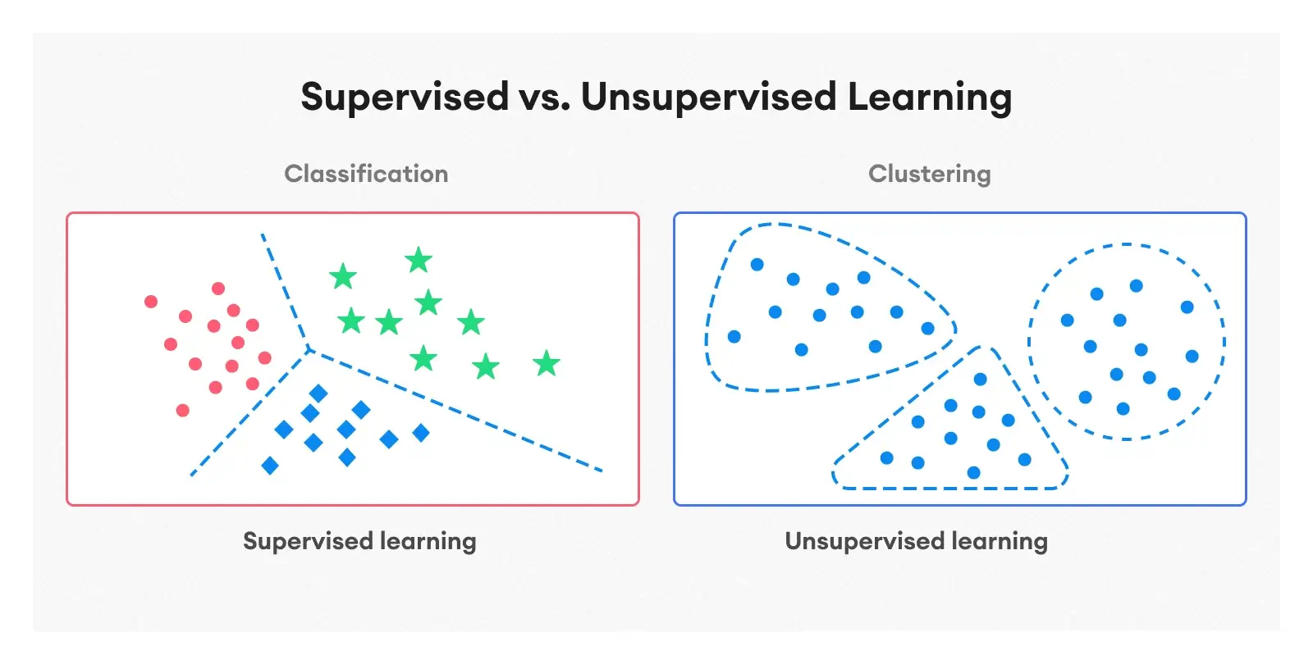
Unsupervised Classification
Unsupervised classification is where the outcomes (groupings of pixels with common characteristics) are based on the software analysis of an image without the user providing sample classes.
Unsupervised learning include cluster analysis, anomaly detection, n
Two popular algorithms used for unsupervised image classification are ‘K-mean’ and ‘ISODATA.’

Slide 8
Image Classification in Machine Learning

Slide 9
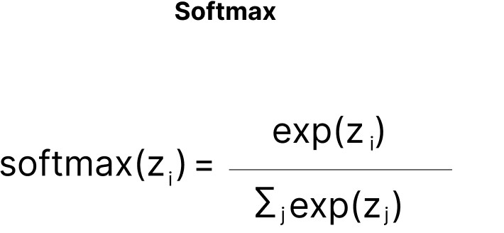
Image Classification-Types
Image classification is a supervised learning problem: define a set of target classes (objects to identify in images), and train a model to recognize them using labeled example photos.
Single –Label Classification :
Single-label classification is the most common classification task in supervised Image Classification.
The output from the model is a vector with a length equal to the number of classes and value denoting the score that the image belongs to this class.
A Softmax activation function is employed to make sure the score sums up to one and the maximum of the scores is taken to form the model’s output.
While the Softmax initially seems not to provide any value to the prediction as the maximum probable class does not change after applying it, it helps to bound the output between one and zero, helping gauge the model confidence from the Softmax score.

Slide 10
Multi-label Classification
Multi-label classification is a classification task where each image can contain more than one label, and some images can contain all the labels simultaneously.
While this seems similar to single-label classification in some respect, the problem statement is more complex compared to single-label classification.
Multi-label classification tasks popularly exist in the medical imaging domain where a patient can have more than one disease to be diagnosed from visual data in the form of X-rays.

Slide 11
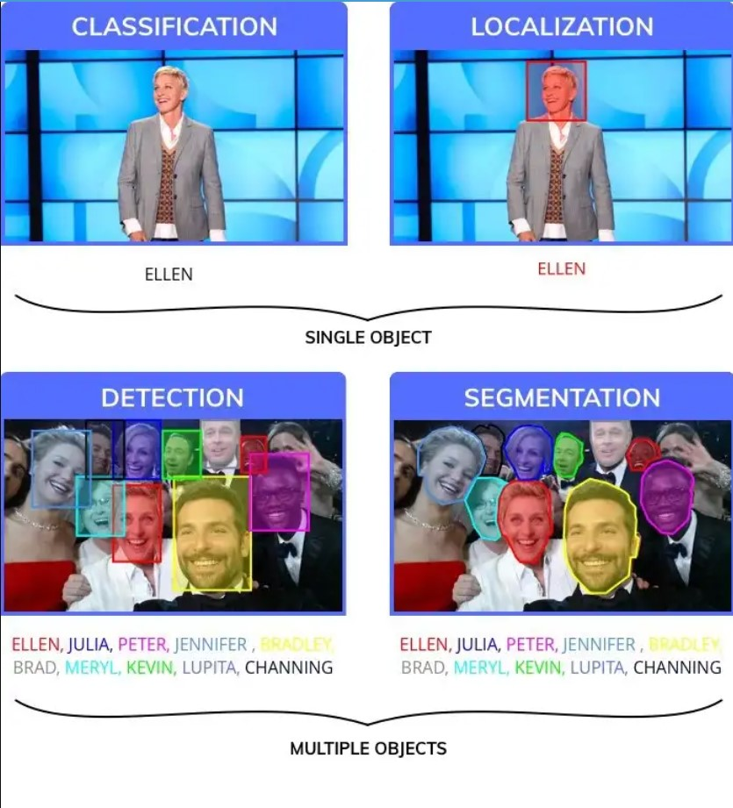
Classification, Localization, Detection and Segmentation

Slide 12
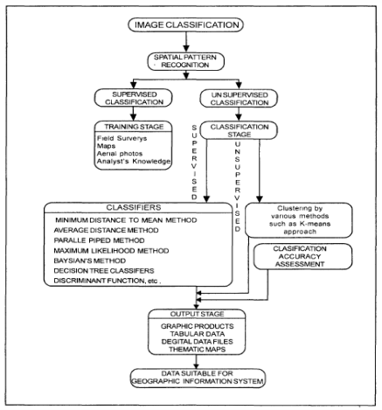
Flow chart of Image Classification

Slide 13
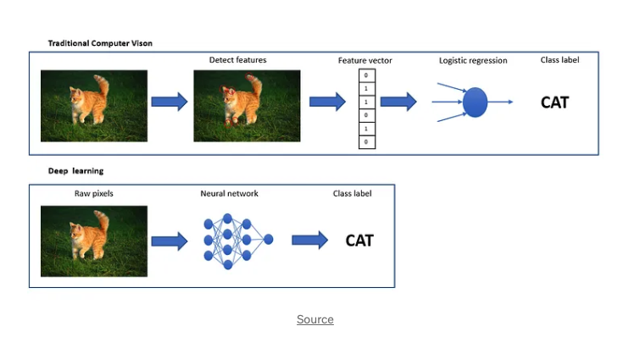
Traditional method for Classification

Slide 14
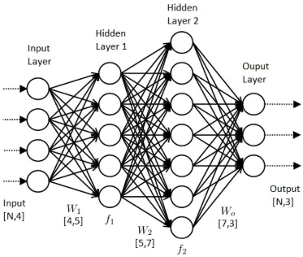
ANN

Slide 15
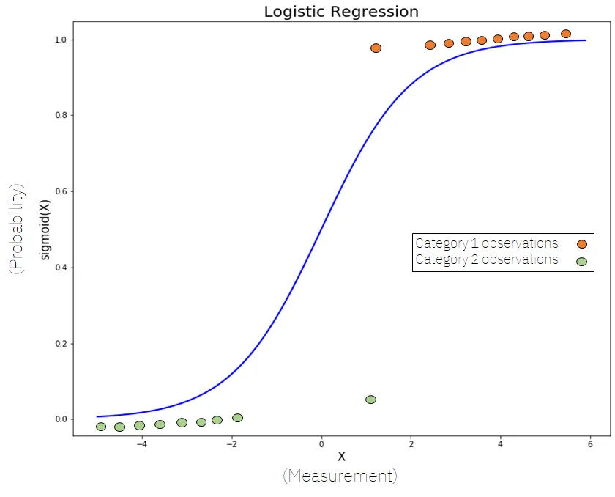
Logistic Regression

Slide 16
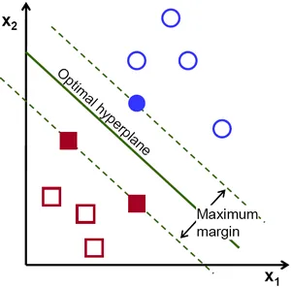
SVM
Support vector machines (SVM) are powerful yet flexible supervised machine learning algorithms which are used both for classification and regression.

Slide 17
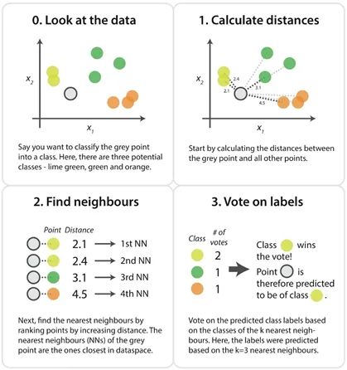
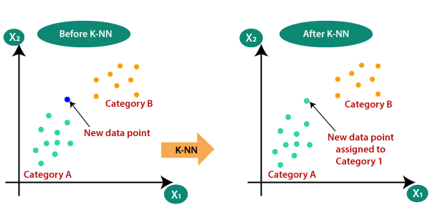
K-NN
K-Nearest Neighbor is a non-parametric method used for classification and regression.

Slide 18
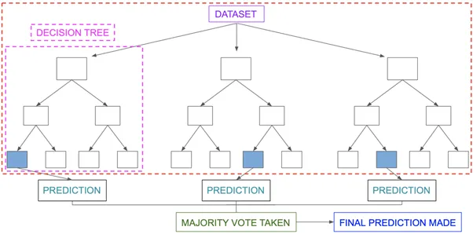
Random forest
Random forest is a supervised learning algorithm which is used for both classification as well as regression.

Slide 19
Image Classification using DL

Slide 20
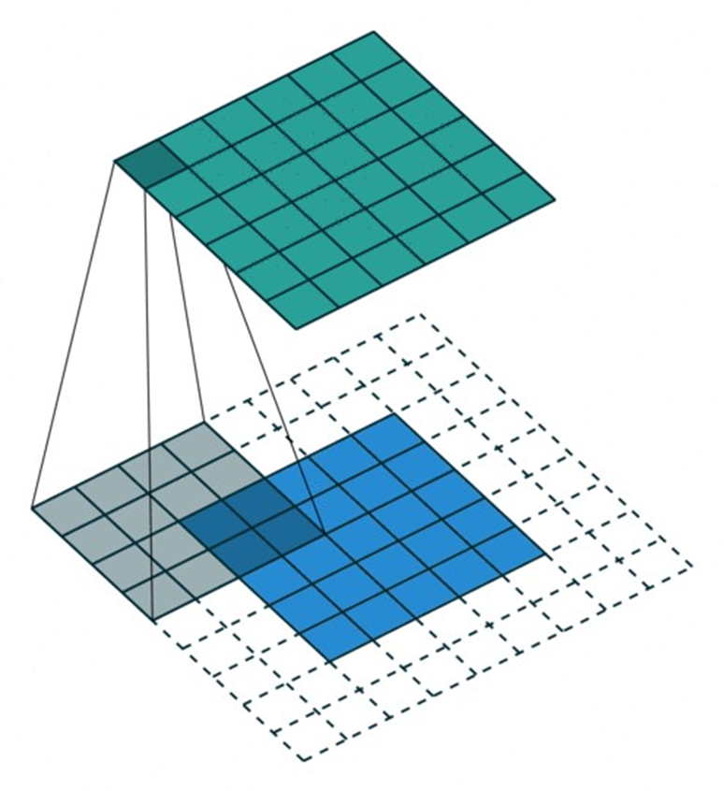
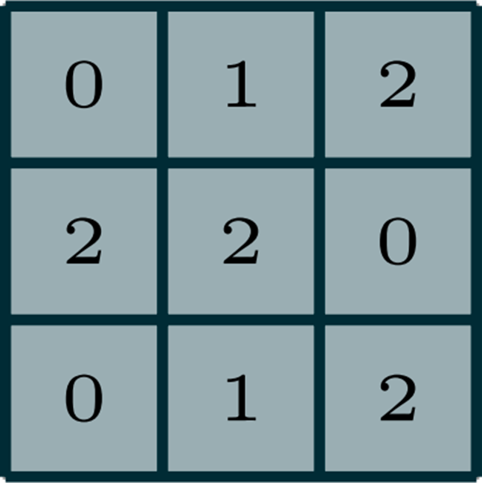
Classification models: CNN
In modern computer vision, the gold-standard model architecture to use is a convolutional neural network.
The convolution operation slides a matrix, called kernel, on input while performing pair-wise matrix multiplication and summing up the result. The following gif shows this process.

Slide 21
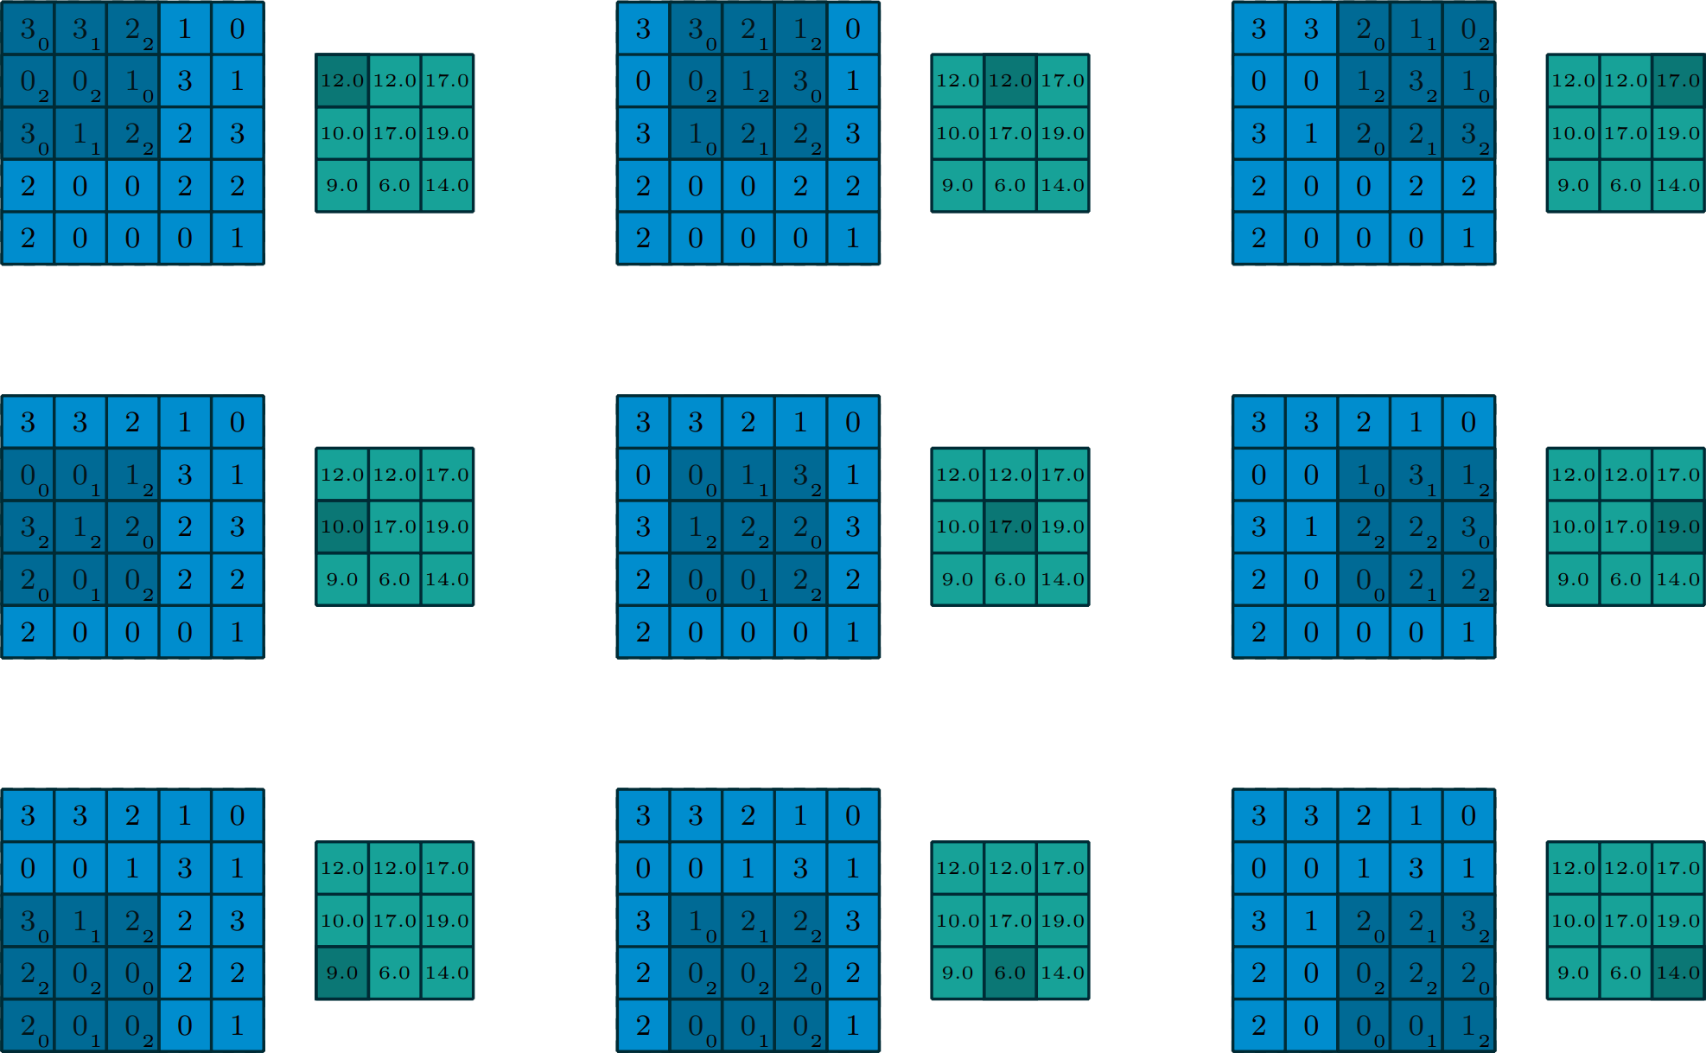
Convolution process

Slide 22
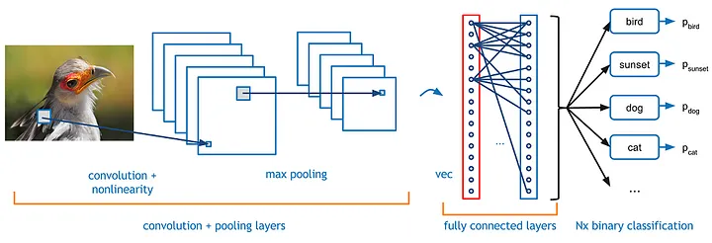
CNN Architecture for Image Classification
Basic CNN architecture for Classification:
The CNN architecture for image classification includes
Convolutional layers,
Max-pooling layers, and
Fully connected layers.

Slide 23
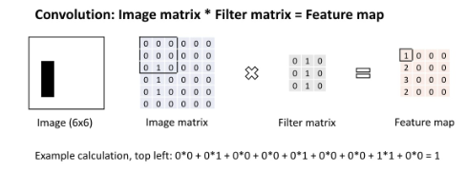
Convolution layer
Convolutional layers apply a set of filters to the input image to extract important features, such as edges, lines, textures, and shapes. Each filter is a small matrix of weights that is convolved with the input image to produce a feature map. Each feature map represents a particular feature or pattern that the CNN has learned to detect in the input image.

Slide 24
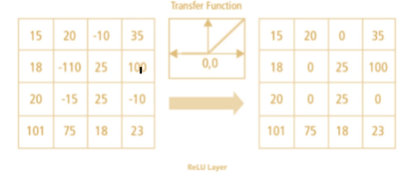
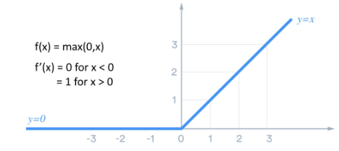
ReLU layer
The output of convolutional layer is passed to, let’s say, rectified linear unit (ReLU) activation function. You can also use other activation functions as well. This introduces non-linearity into the model.

Slide 25
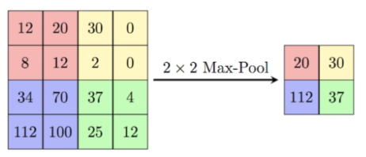
Max Pooling layer
This layer down-samples the feature maps produced by the second convolutional layer, further reducing their dimensionality

Slide 26
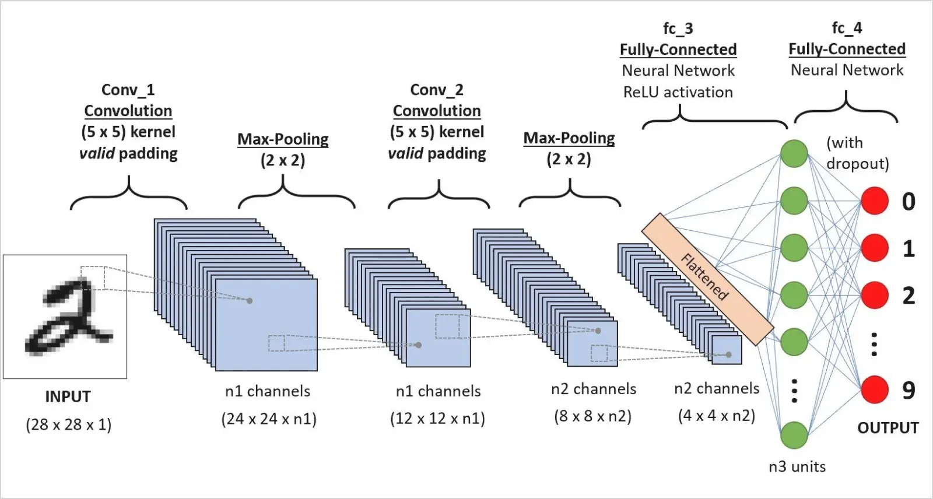
Basic CNN architecture for Classification

Slide 27
Applications
Medical and Healthcare
Manufacturing
Security
Agriculture
Autonomous Vehicles

Slide 28
Image Representation

Slide 29
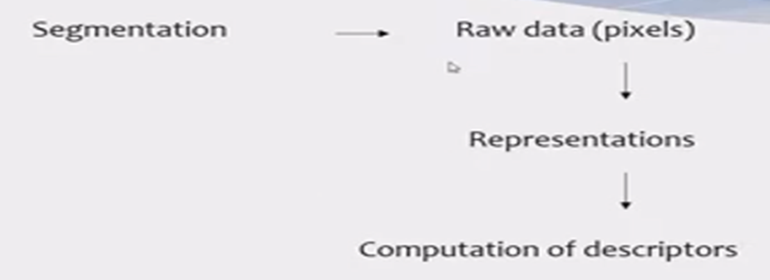
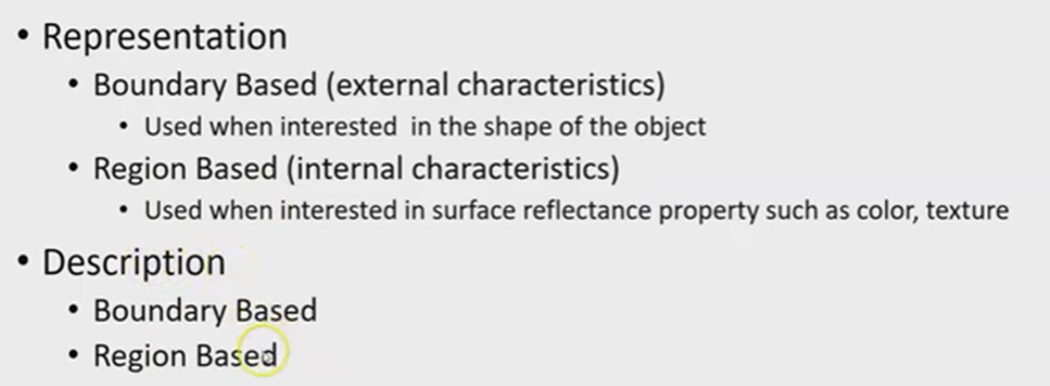
Representation and Description
Representation and description almost always follow the output of a segmentation stage, which usually is raw pixel data that constitutes either the boundary of a region or all the points in the region itself.
Description deals with extracting attributes that result in some quantitative information of interest or are basic for differentiating one class of objects from another.

Slide 30
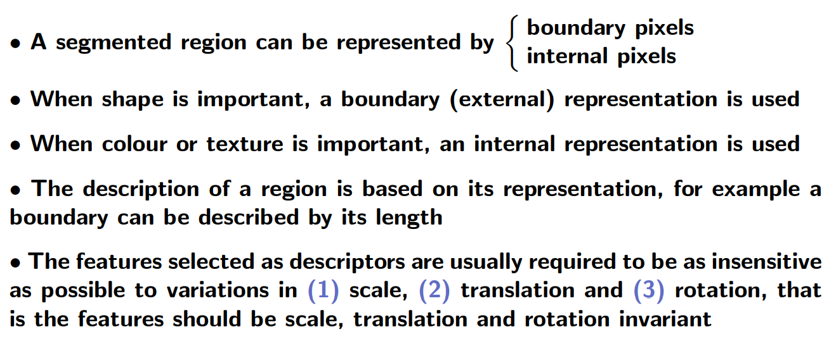
Representation and Description

Slide 31
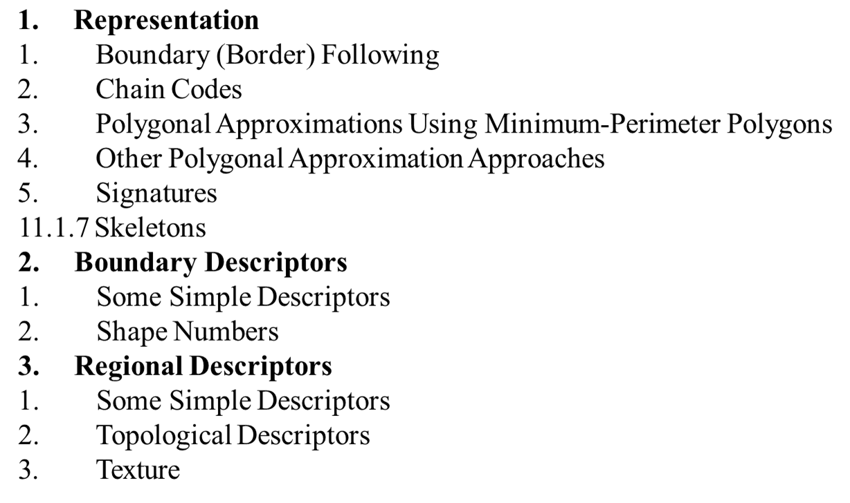
Methods for Representation and Description

Slide 32
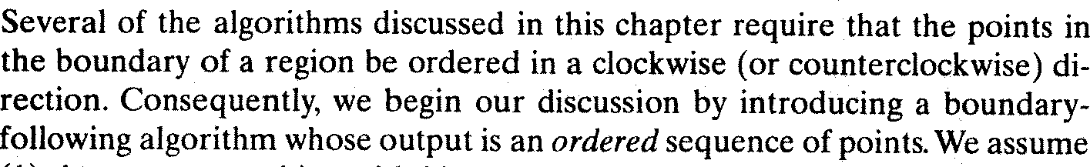
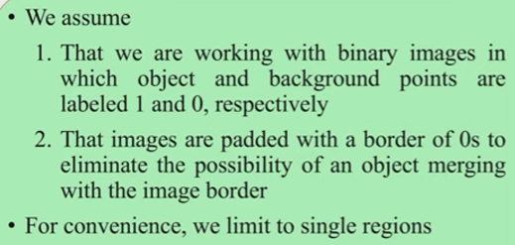
Representation:
Boundary Following:

Slide 33
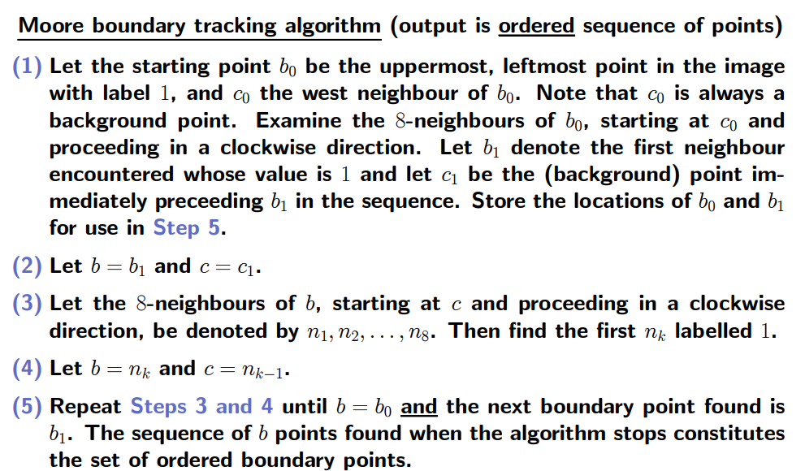
Representation: Boundary Flowing Algorithm

Slide 34
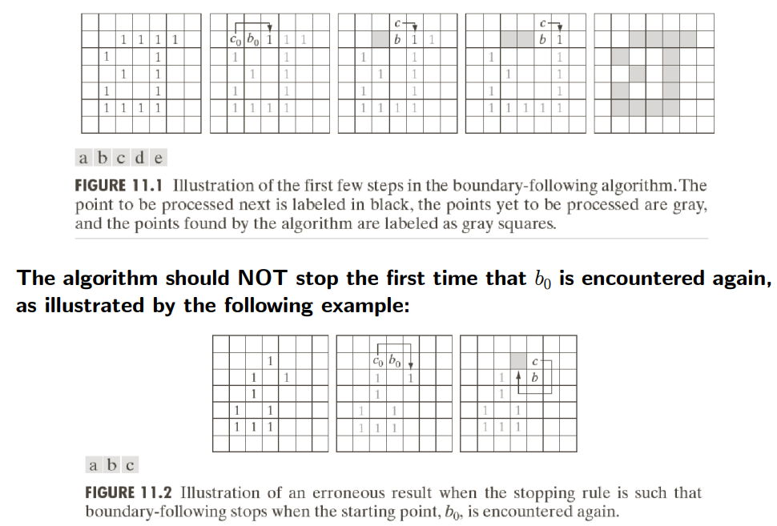

Slide 35
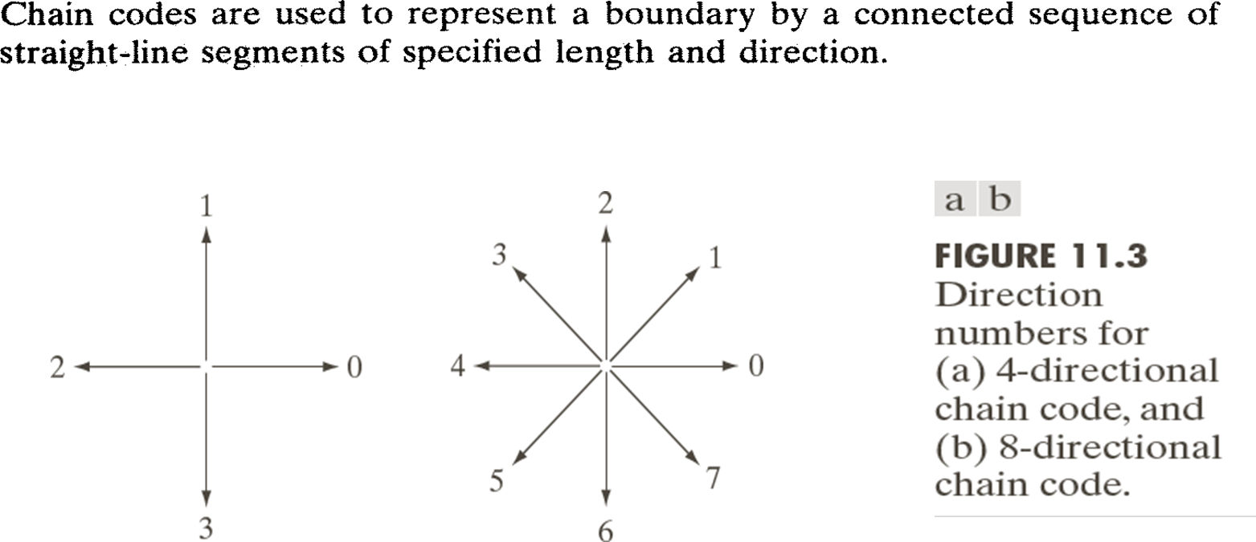
Representation: Chain codes

Slide 36
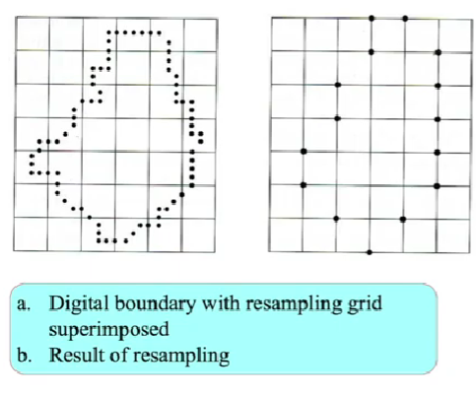
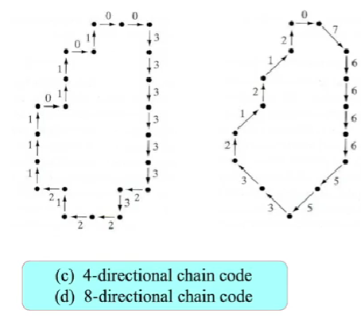
Representation: Chain codes example

Slide 37
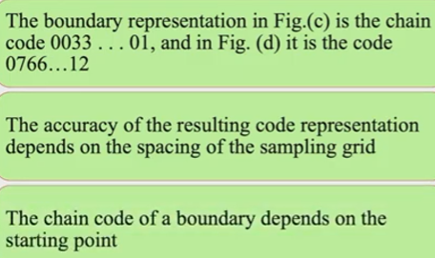
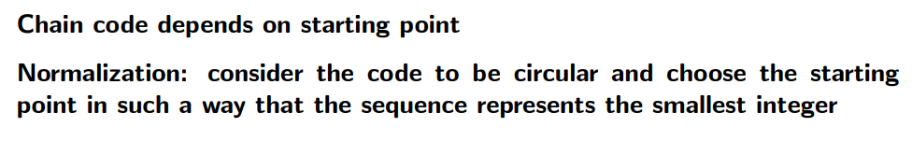
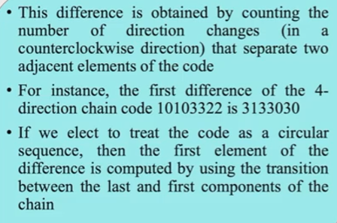
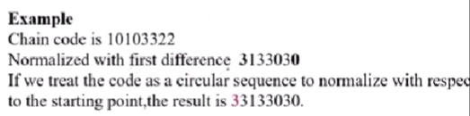

Slide 38
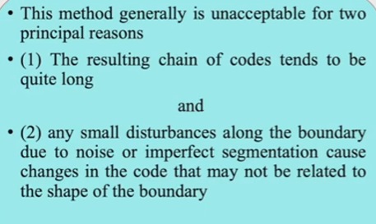
Chain code disadvantages

Slide 39
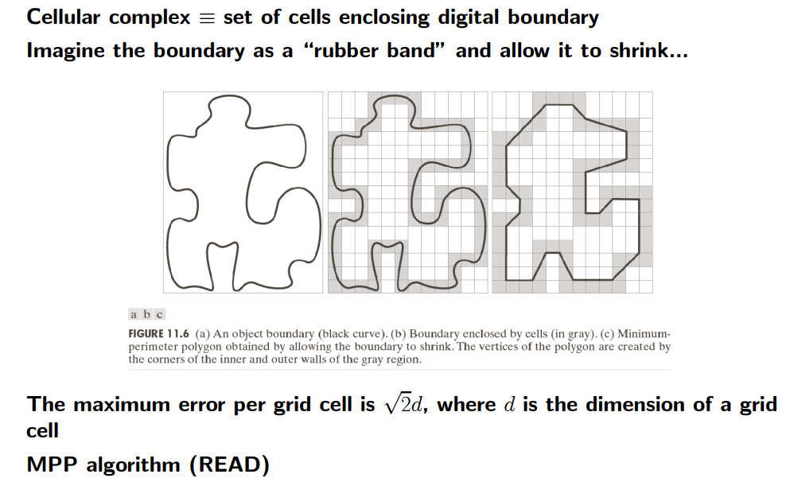
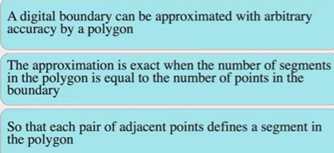
Representation: Polygon Approximation using Minimum perimeter polygon(MPP)

Slide 40
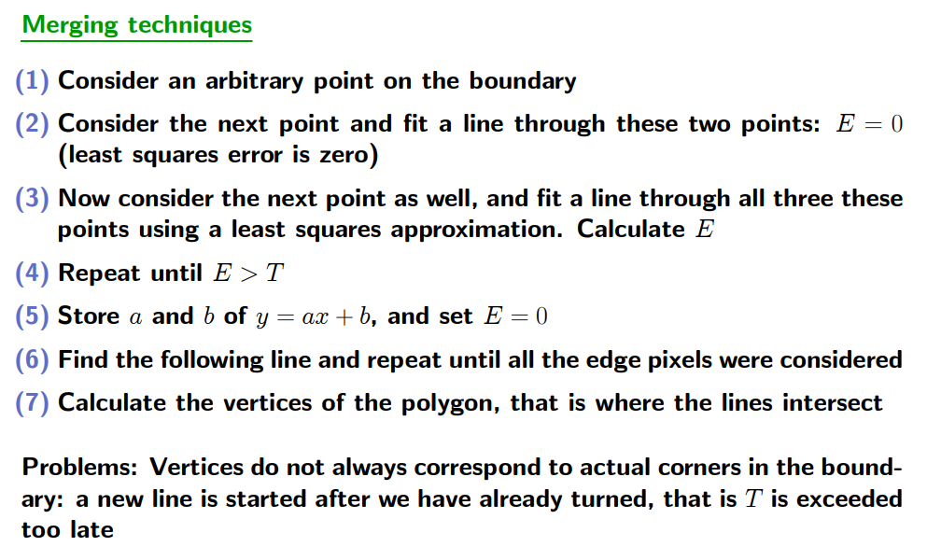
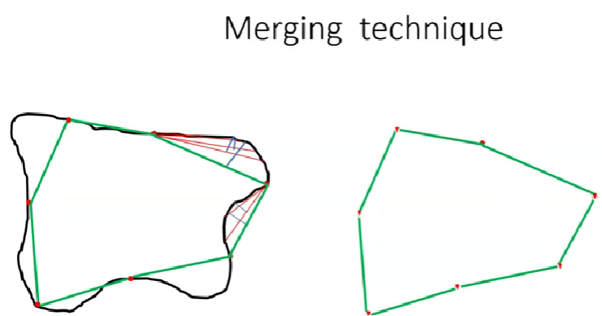
Representation: Other polygonal Approximation methods-Merging Technique

Slide 41
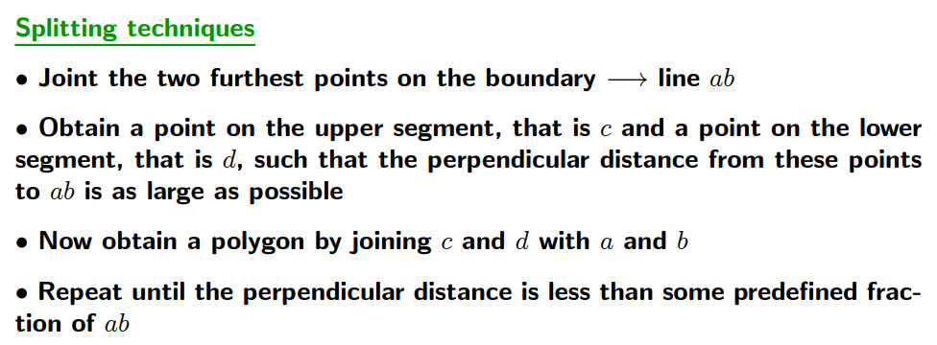
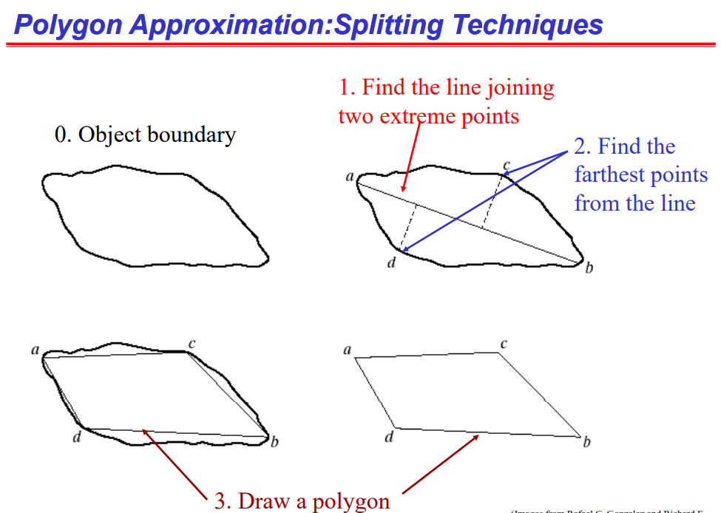

Slide 42
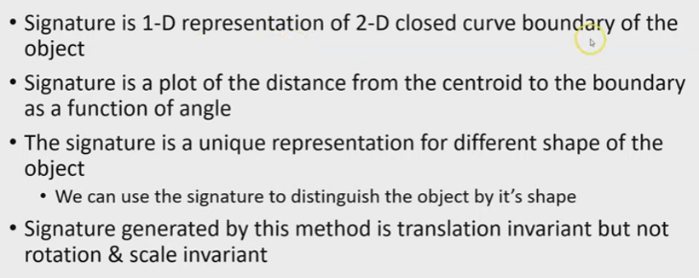
Representation: Signatures

Slide 43
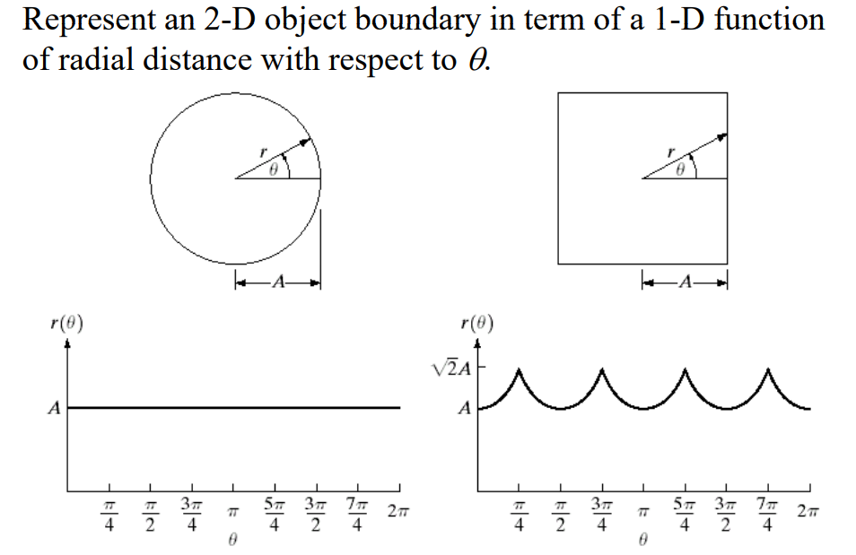
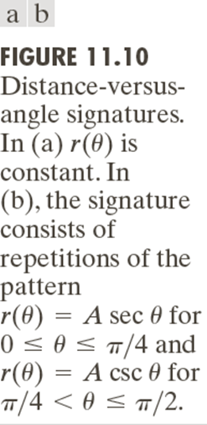
Representation: Signatures-Example

Slide 44
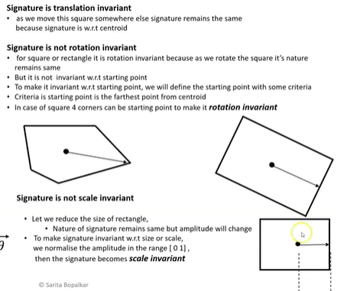

Slide 45
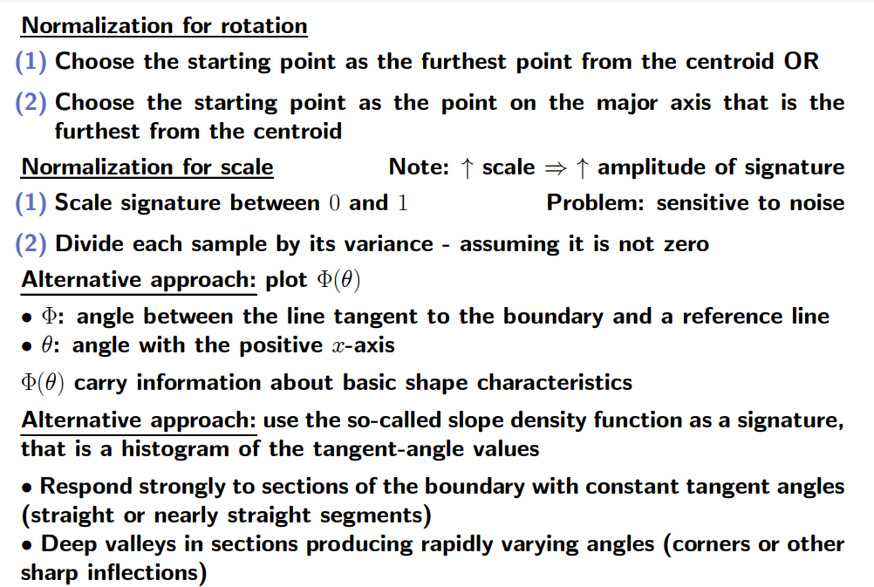

Slide 46


Representation: Signatures-Example

Slide 47



Representation –Boundary Segments

Slide 48

Representation : Skeleton- Medial Axis Transformation

Slide 49


Slide 50


Slide 51


Representation : Skeleton- Thinning Algorithm

Slide 52


Slide 53

This means check isolated point at least
2-6 neighbours
b) It is not a corner or Junction point.
d) = at least any one pair is zero .
It checks it is a part of Horizontal, vertical,
Diagonal line.
C’),d’) = at least one is zero in the pair. It
Check part of opposite diagonals.
After checking all only make it as zero.
The above are the algorithm explanation.

